Slide 1
HOMEWORKOUT MANAGEMENT
Presented By:
Rohan Sudhir Sawase

Slide 2
Group member
Name of Student | Enroll ment no
Datta Bharat Bhad | 1901200220
Ganesh Chhagan Bhad | 1901200219
Gunadnya Prakash Sawadh | 1901200229
Prasad Mahadev Pawar | 1901200197
Rohan Sudhir Sawase | 1901200209

Slide 3
INTRODUCTION
Gyms are become the essential part of our lives, providing best exercise and body building facilities to our society. Therefore, at the management end there are some necessary steps to maintain the records of every individual including trainer, trainees, and staff But maintaining the records on paper is very difficult So, it is necessary to have a computerized system that manages all these issues.
Thus working on the management system for Gym Industry are the basic of our project. We have developed an automated version of the manual system, named as Homeworkout Management System. This system also provides excellent security of data at to its user.

Slide 4
APPLICATION DESCRIPTION
Customer
- View many types of exercies and Diet plane.
- Make a Schedule
- In Schedule Day ,Workout title and Workout Discription.
- Maintain Our Body
Admin
- Generate a GYM package , Add member, Create Diet list, Add Schedule and View member.
- Decision making for purchesing

Slide 5
PROJECT SCOPE
The administrator has the full fledged rights over this system.
The admin can register and view the customers profile data.
The admin can make announcement about any thing.
The admin can upgrade gym packages at any time.
Customer can contact with the admin through message box any time.
Customer can avail the diet plan of their own desire.
Customer can get more updates from the system by joining different social accounts.
Customers can view updated diet plan , updated exercises schedule , and can question to admin and view the answer.
Customers can contact with other gym mates online.

Slide 6
PROJECT GOAL
Provide a platform with interactive user interface for both customer and admin.
Save the time of both admin and customer.
Get online plans in effective manners.
To save cost of each user.
The one who cannot afford gym packages ,also get benefits by viewing different exercise , diet plan tutorials.
User friendly.
Update Monthly OR weekly.

Slide 7
SOFTWARE requriment
Tools :
Android Studio
- Java language used in our project .
- used a lot of multiple labraries
- We used a android version 8.
- Used XAMPP
- Server are Mysql and Apache

Slide 8
SOFTWARE requriment
PHP
- The administration of a MYSQL or Database server.
- You can used php to vreating a database, runing queries and adding user accounts.
- Used to link Database.
Sublime
-Support to create web servies.
- Sublime text click user interface along with its numerious extentions for syntax highlighting.

Slide 9
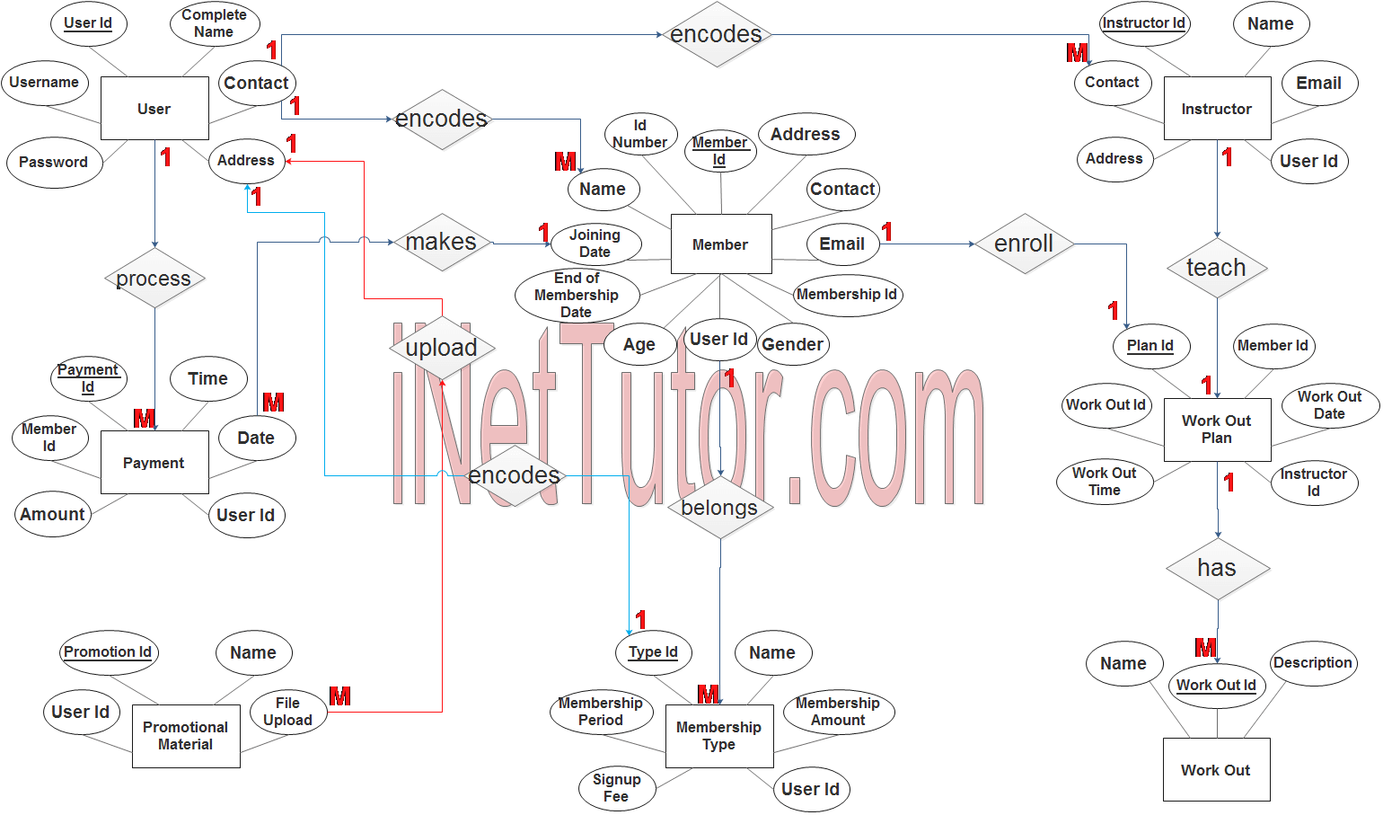
ER Diagram

Slide 10
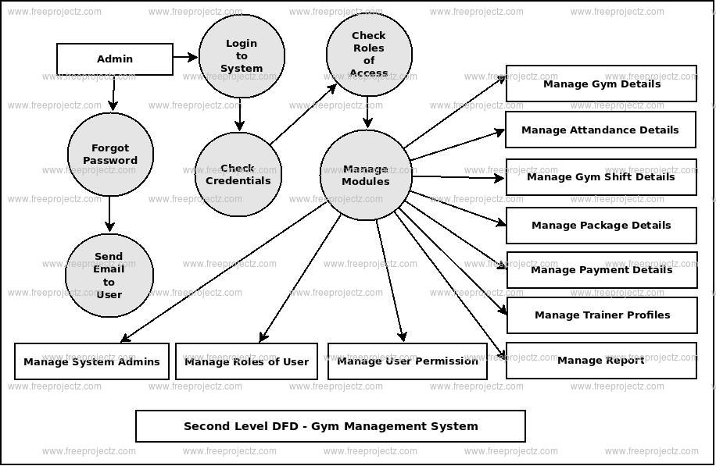
E-r Diagram for admin

Slide 11
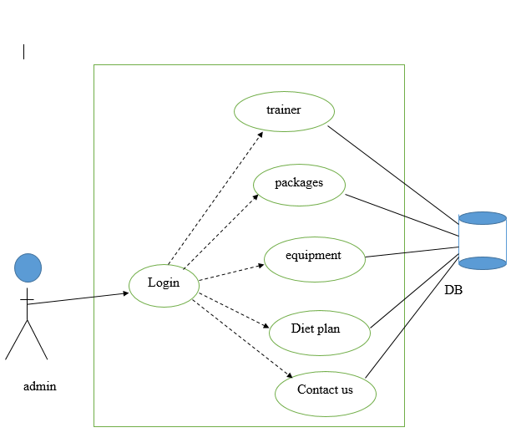
Admin Use case Diagram

Slide 12
Testing
The following tests is applicable to our system
Unit Testing
Performance Testing
User Interface Testing
Security and Access Control Testing
Installation Testing
Acceptance Testing

Slide 13
Problems encountered
Internationalization (i18n)
Different language, different encoding, even different format
Calculating the correct price of orders
Many factors affecting the price
Generating JavaScript dynamically
User Interface
Validation

Slide 14
Functionality performed by admin
Login
Manage user
Approve user
Equipment data
Message box
Trainer data
Update fee
Update packages
Diet plan
Contact us
logout

Slide 15
Screen shots

Slide 16
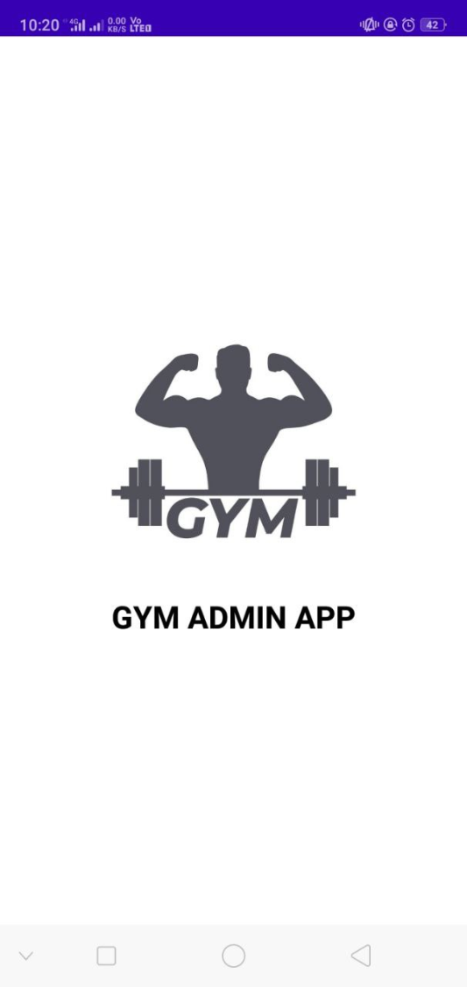
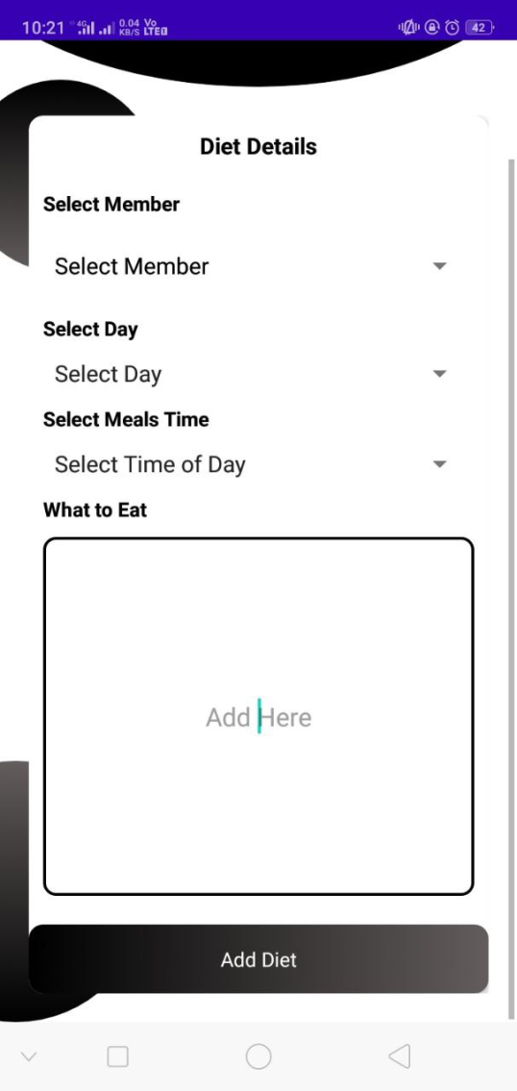

Slide 17
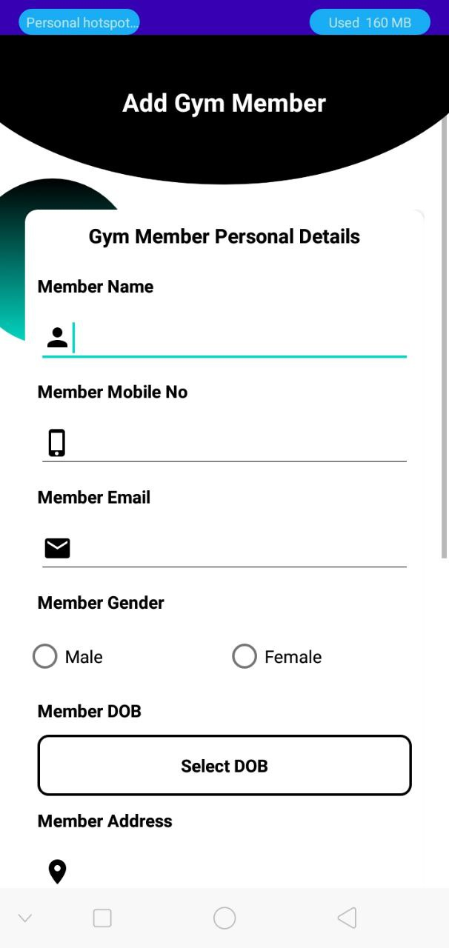
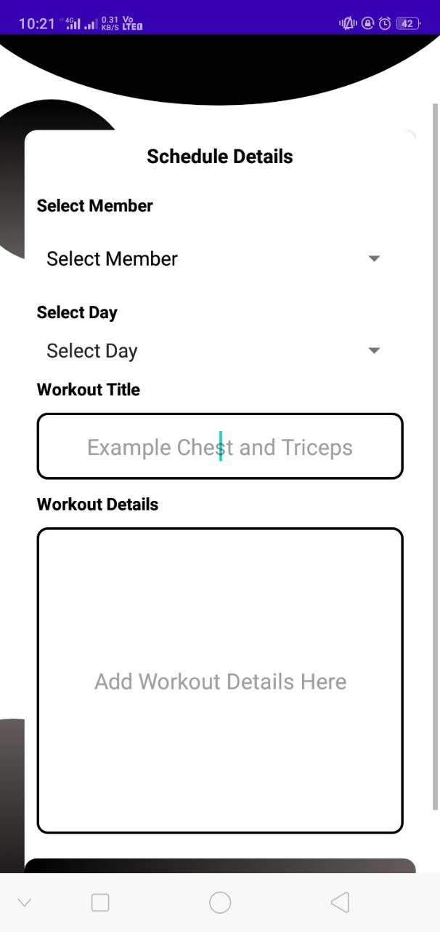

Slide 18
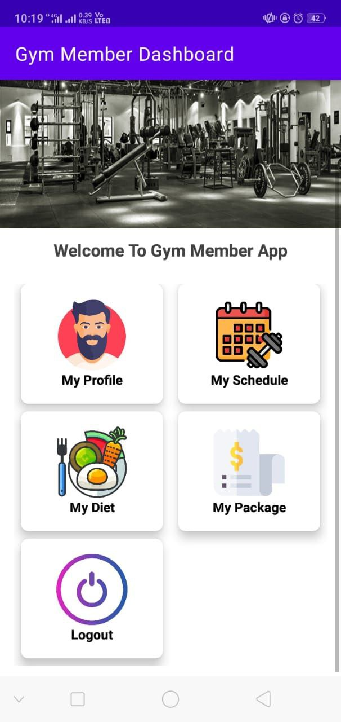
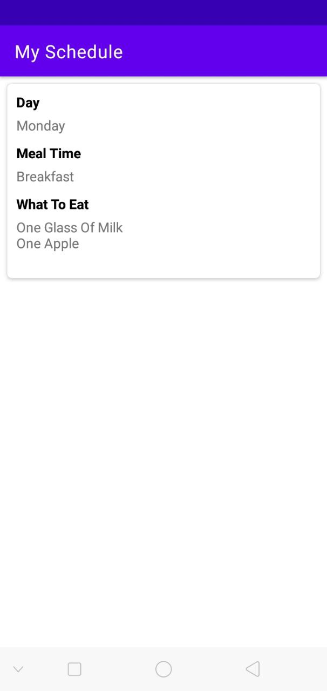

Slide 19
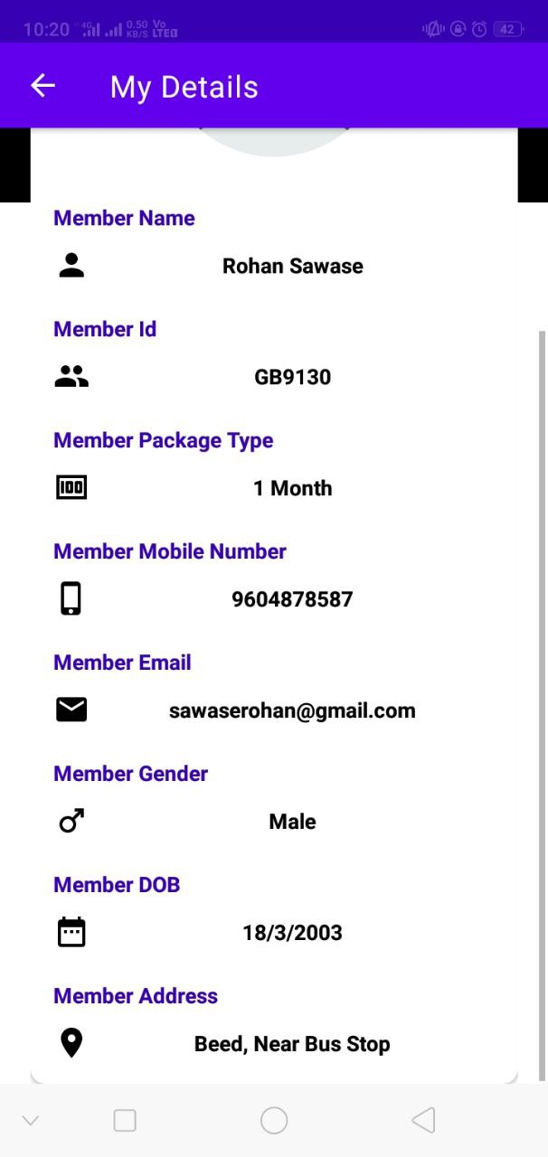
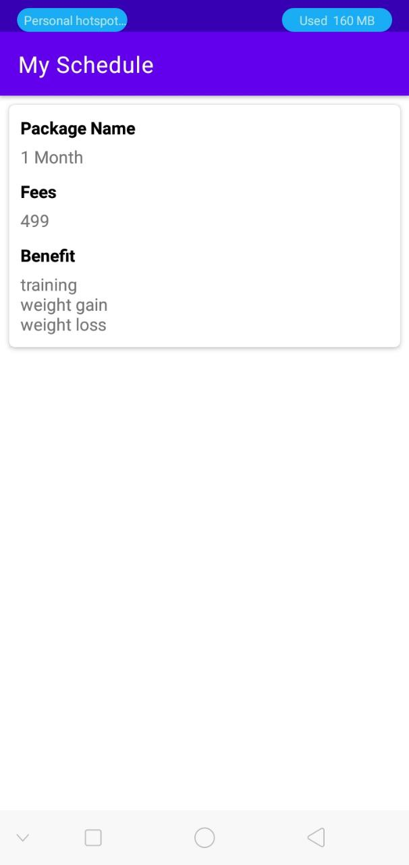

Slide 20
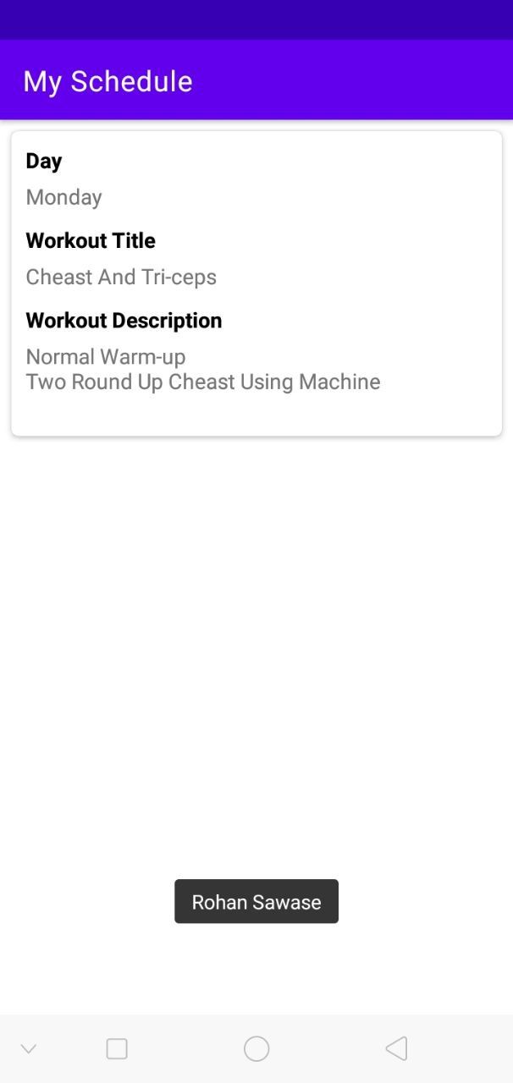

Slide 21
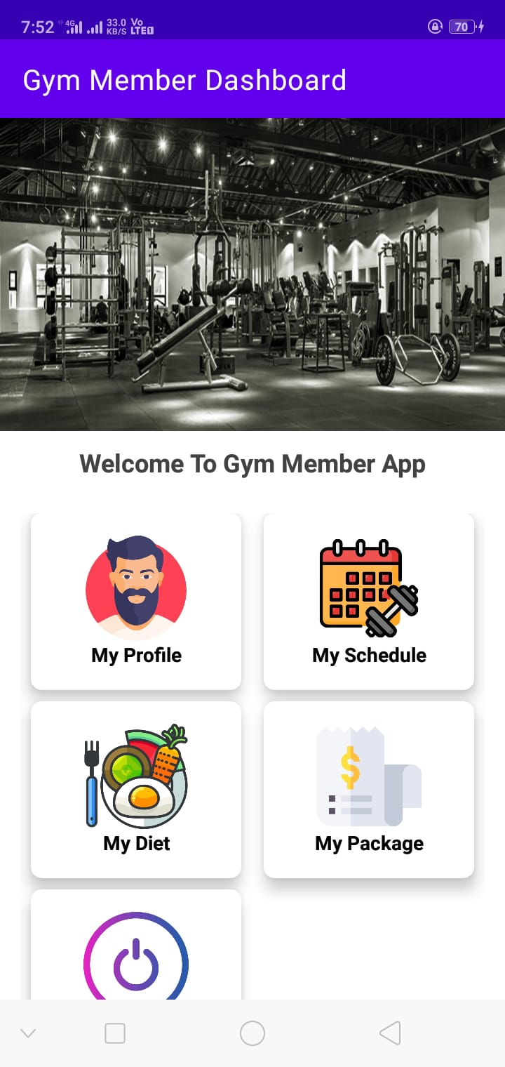
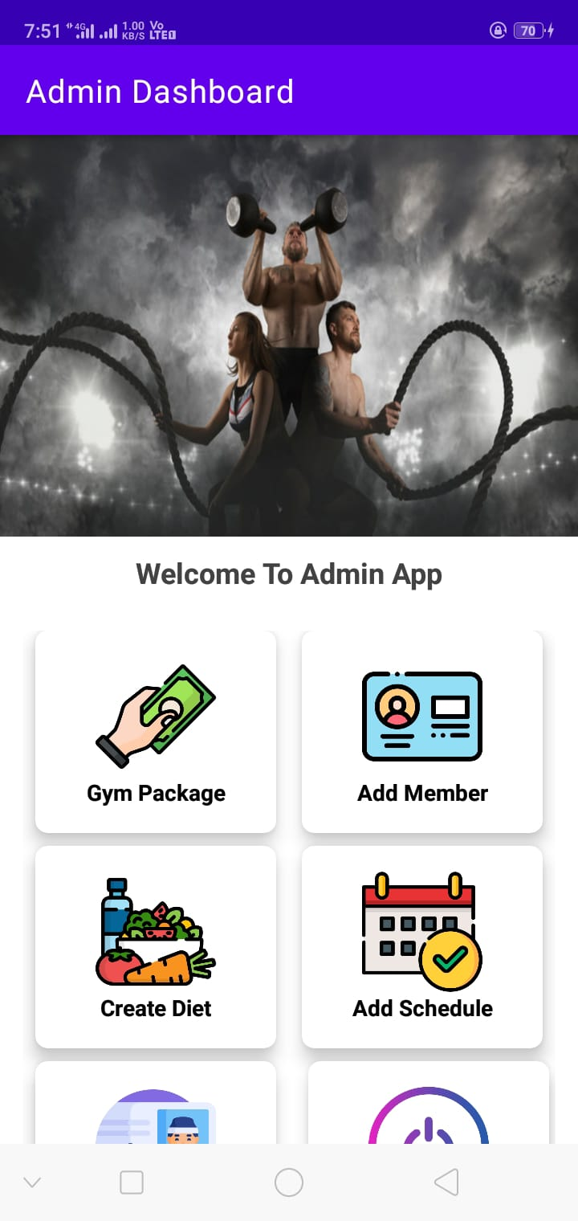

Slide 22
Conclusion
This project was designed to implement a system that will be used for election process using the staff elections of the University of Ibadan as case study.The integration of biometric authentication within the system will provide an efficient way to cast votes, free of fraud, and make the system more trustable, economic and fast as well as enabling the voters to cast their votes from any location as a result of the online voting module which can be accessed from any device with internet connectivity. The use of fingerprint recognition deepens the process of ensuring that the voting mantra-one man, one vote is fully enforced. The project is of immense benefits to the University as it protects and secures the integrity of the university's staff elections, reduces administrative work and improves the staff election’s creditability rating which subsequently strengthens internal democracy and trust among the

Slide 23
REFERENCE
Google
Android Studio Website
Websites
Teachers
Other Hands
www.Google.com
Alins, K. "Comparison of Various Biometric Methods". Interactive Multimedia Systems.Electronic and Computer Science, University of Southampton, pp 2, 2010
. Altun A.A. Kocer H.E, Allah Verdi, "Genetic algorithm based feature selection level fusionusing fingerprint and iris biometrics". International Journal Pattern Recognition ArtificialIntelligence (UPRAI), 22(3): 585-600, November 2008

